Slide 1
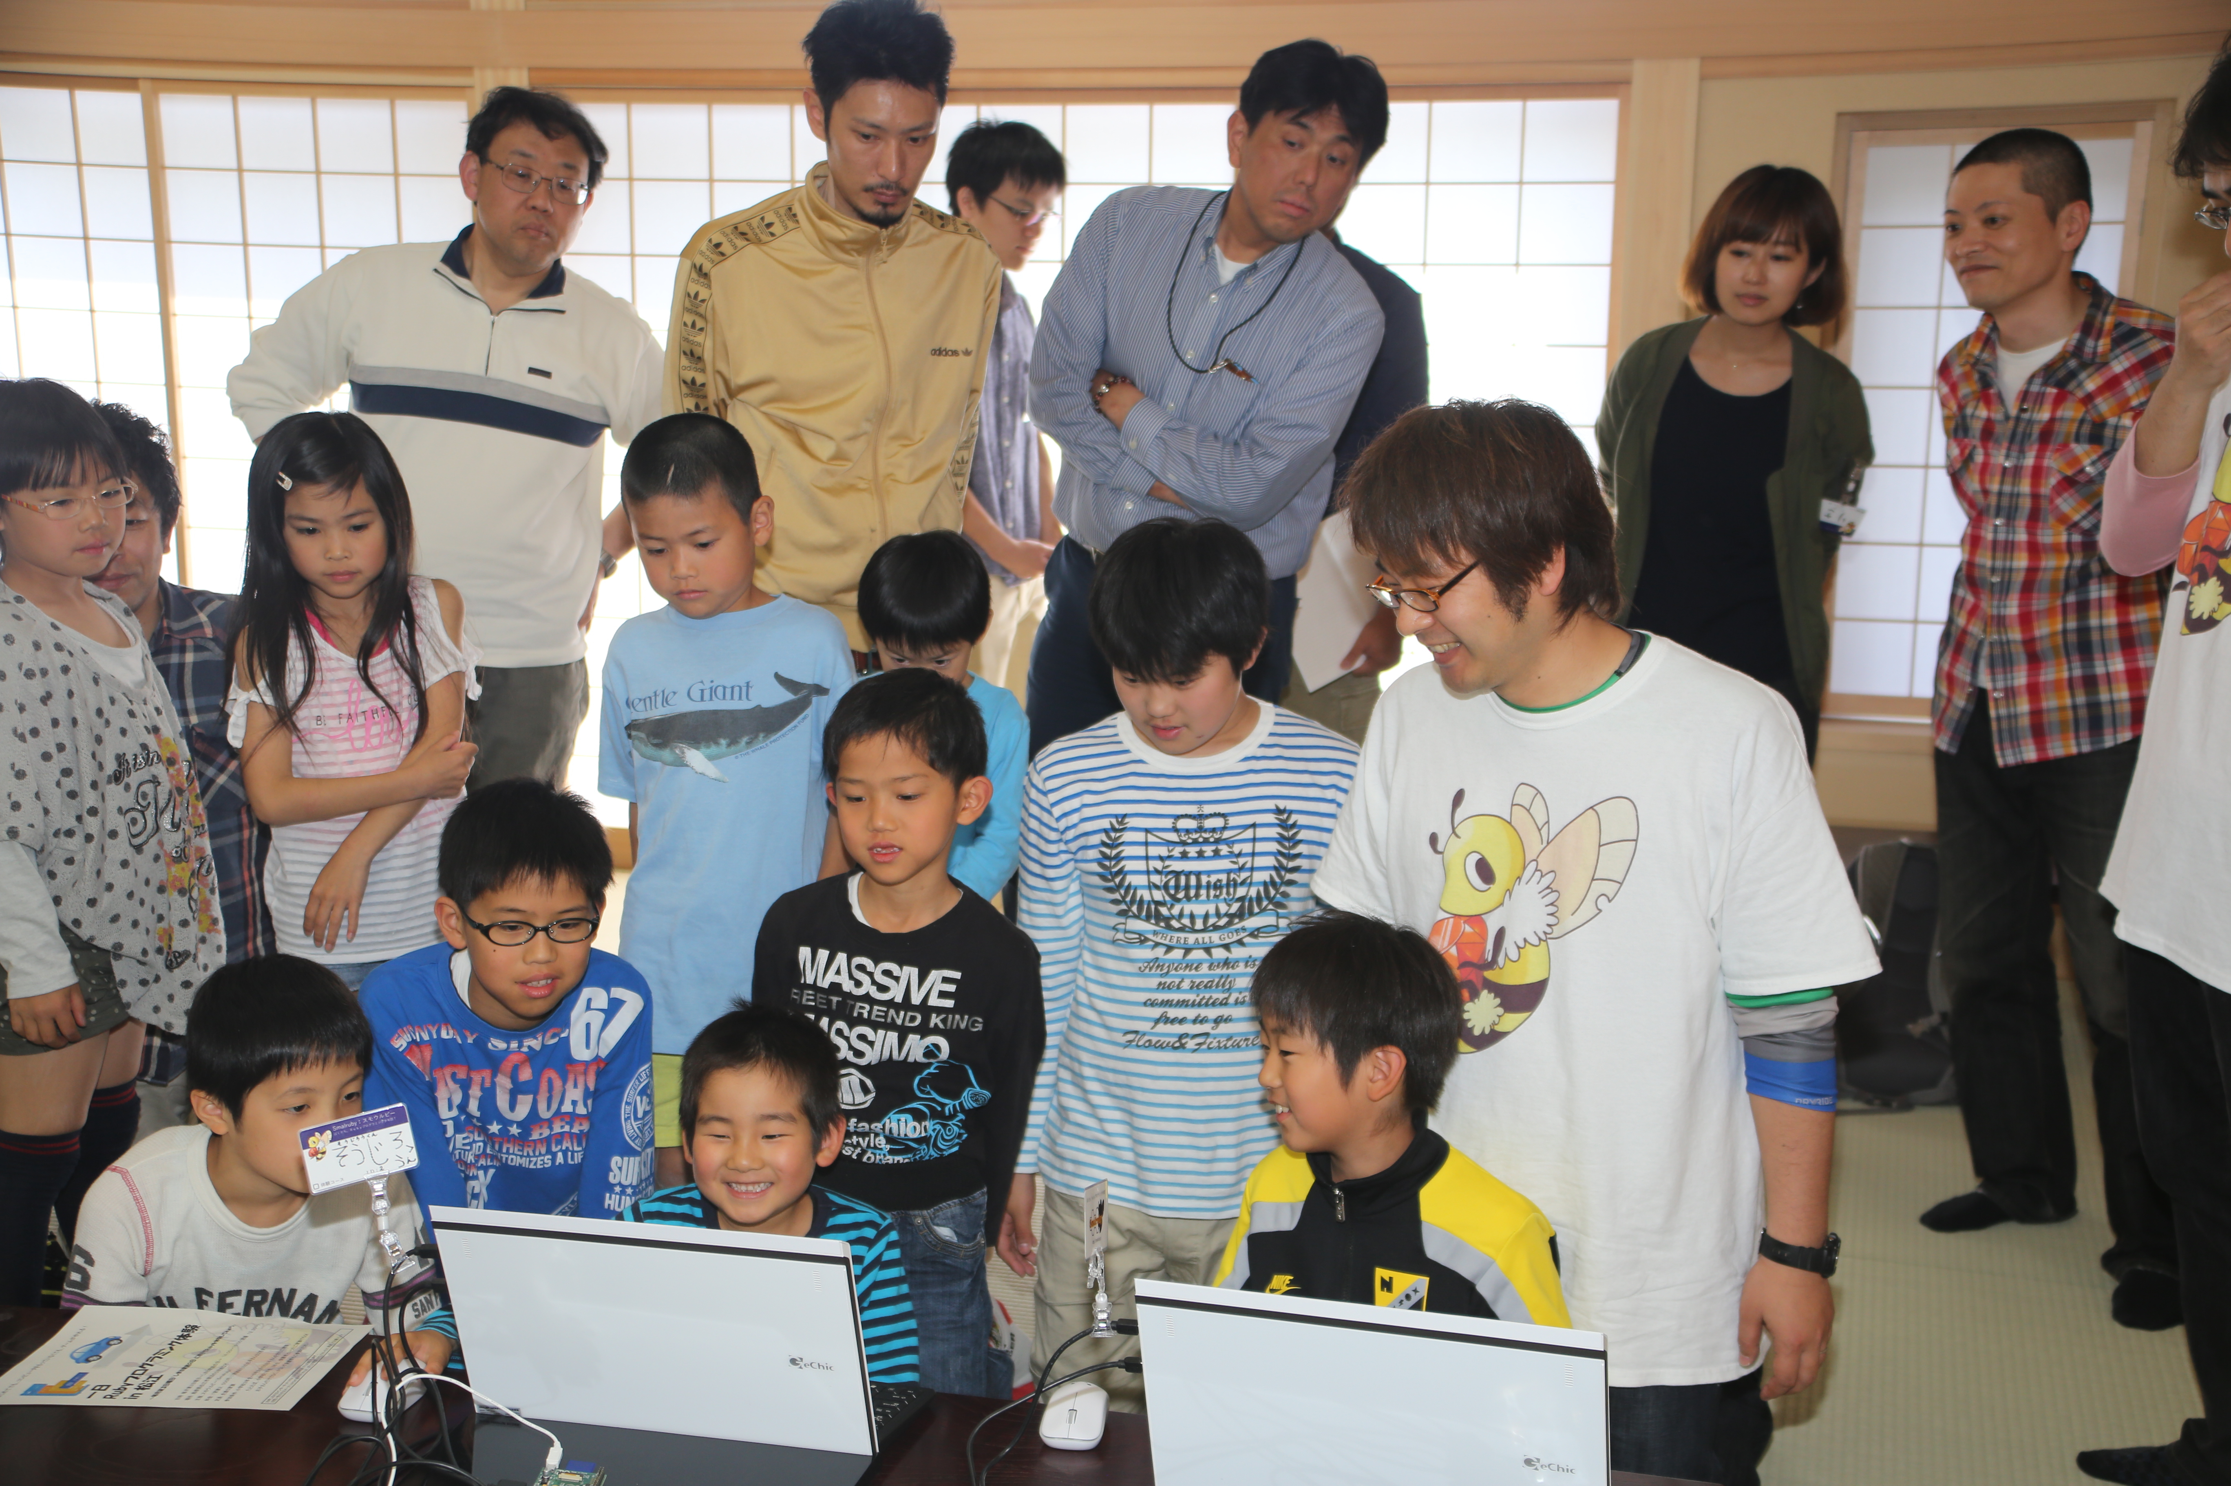

Kids Fun Ruby!
Introduction of the Smalruby and the Ruby Programming Shounendan
Kouji Takao and Nobuyuki Honda,
The Ruby Programming Shounendan,
RubyKaigi 2014, 09.19.2014

Slide 2
Kouji Takao
A leader of the Ruby Programming
Shounendan, CRuby commiter
kouji@smalruby.jp
@takaokouji
高尾 宏治
Nobuyuki Honda
A chief education officer of
the Ruby Programming shounendan
nobyuki@smalruby.jp
@nobyuki
本多 展幸

Slide 3
Nobuyuki Honda
A chief education officer of
the Ruby Programming shounendan
nobyuki@smalruby.jp
@nobyuki
本多 展幸
Kouji Takao
A leader of the Ruby Programming
Shounendan, CRuby commiter
kouji@smalruby.jp
@takaokouji
高尾 宏治

Slide 4
Sponsored by
NaCl
Nobuyuki Honda
A chief education officer of
the Ruby Programming shounendan
nobyuki@smalruby.jp
@nobyuki
本多 展幸
Kouji Takao
A leader of the Ruby Programming
Shounendan, CRuby commiter
kouji@smalruby.jp
@takaokouji
高尾 宏治

Slide 5
NaCl is
SIer

Slide 6
NaCl has
30
Rubyists

Slide 7
NaCl has
6
Commiters

Slide 8
Please
come to
visit out
NaCl♪

Slide 9
Kids Fun Ruby!
Introduction of the Smalruby and the Ruby Programming Shounendan
Kouji Takao and Nobuyuki Honda,
The Ruby Programming Shounendan,
RubyKaigi 2014, 09.19.2014

